Slide 1

Tableau Desktop

Slide 2
What is data Dashboard?
A data dashboard is an information management tool that visually tracks, analyzes and displays key performance indicators (KPI), metrics and key data points to monitor the health of a business, department or specific process. (Source: Wiki)

Slide 3

4 W’s of a good dashboard
Who is you target audience?
What do they actual know?
Where will they view the dashboard?
Why are you building it?

Slide 4
Who is the dashboard for?
Who is the intended audience of the dashboard?
1. You
No explanations needed
Can include more advanced charts
Doesn’t have to look as polished
2. Team
Consider the visualization
3. Your Department
Add more explanations and terminologies

Slide 5
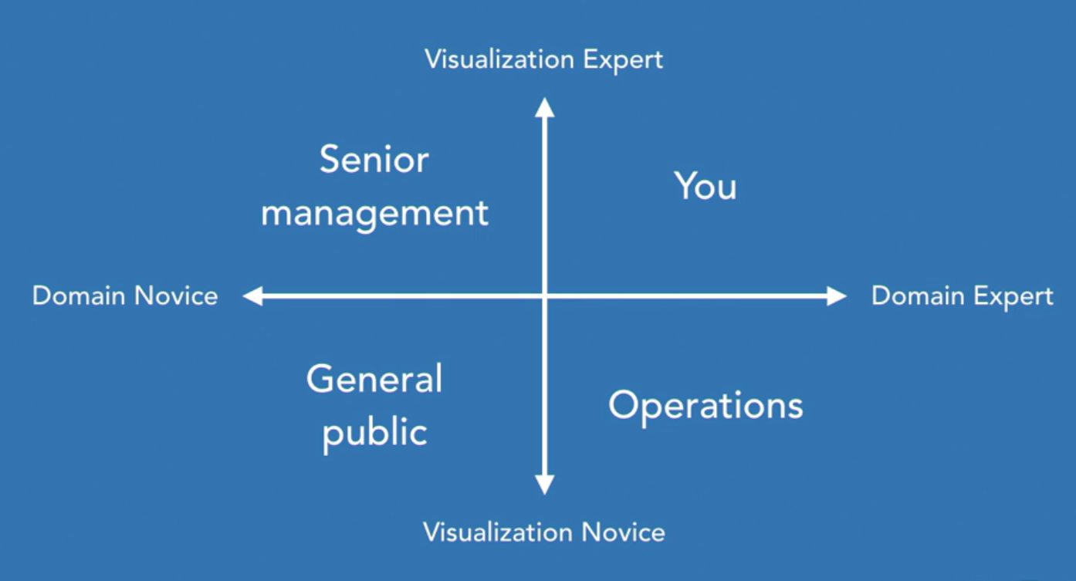
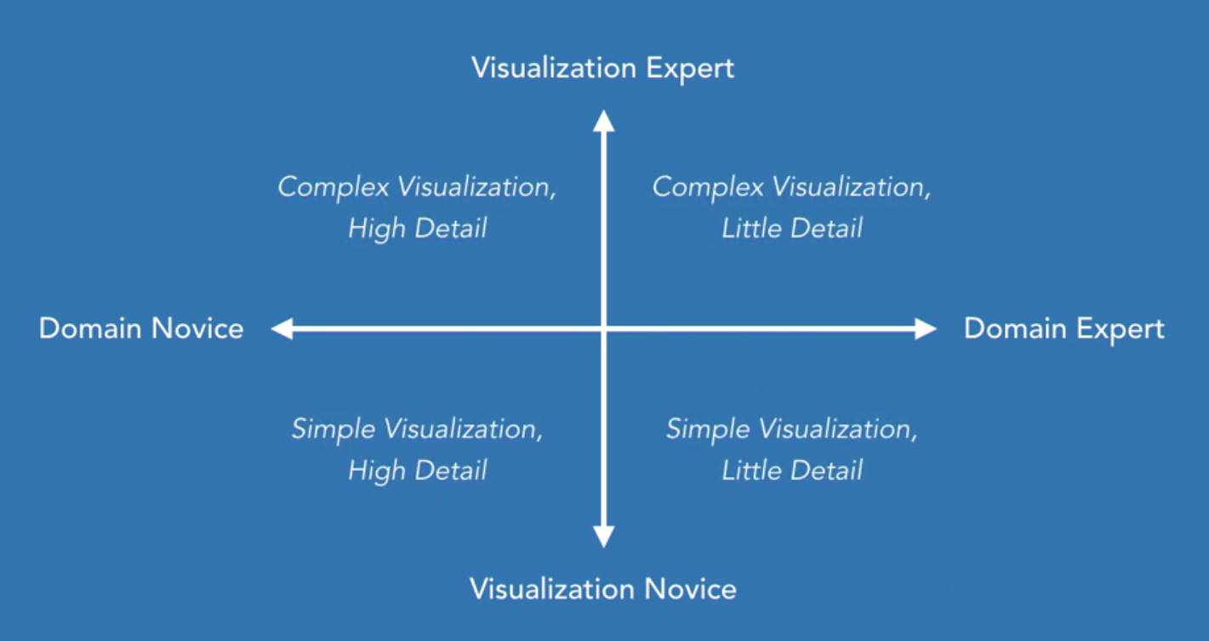
Visualization details

Slide 6
Where is the dashboard viewed?
Laptop/Desktop
Tablet/Mobile device
Print/ TV display.
Dashboard Size
Level of interactivity

Slide 7
Why are we making this dashboard?
Types of Dashboard
Exploratory: - Built for discovery.
Informative: - Built for information.
Explanatory: - Built for insight.
Key performance indicator:- Built for attention.

Slide 8
What data will the dashboard show?
What elements will help?
What data do we need to display?
High or low level of detail?
Live or extracted data?
What do we need to include or exclude?
What is the minimum viable information required?

Slide 9

Tiled layout
Grid layout, for standard dashboards.
Easy alignment/rigid structure.
Hard to place objects.

Slide 10
Floating
No grid; placed anywhere
No snap to grid
Allows for creative freedom

Slide 11
Tableau Dashboard components

Slide 12
Apply filter across sheets
Filters reduces the amount of data displayed.

Slide 13

Filters
Filters automatically gets added to the dashboard if it is in sheets.
Can also be added to a dashboard (if it is not in sheets).
But it must exist in the sheet.
How to make filters apply to some sheets, but not to others.
Where should we place the filter?

Slide 14
Highlight data using Annotations
Labels to highlight something interesting in the data.
Can be linked to an axis or a mark.
Ensures the viewer will see the important details.
Particularly good for explanatory dashboard.

Slide 15

Info buttons in dashboard
Instructions on how to read dashboard or where the data came from.
Help or information button as to not take a valuable space.

Slide 16
Use collapsible containers to show information as needed.
Useful way to hide containers. Examples can be filters, Parameters, Help text.
Make sure all elements are needed on the dashboard.

Slide 17
Dashboard colors are easy to get wrong
Too much color adds to confusion.

Slide 18
Selecting Color
Should enhance the data.
Should come from questions you are trying to answer.
Don’t use color just because you can.
Should enhance, not distract.

Slide 19
Chart junk
Information that distract from the data.
It is important because space is precious on the dashboard.
Every element should contribute to the dashboard.
Delete if it doesn’t enhance the data.

Slide 20
Group elements
Some time its important to group elements on a sheet to show they are related.
Put a border around them.
Use a colored background.
Use layout containers.

Slide 21
Creating Interaction
Add interaction with dashboard actions.
We want user to engage with our dashboard.
Invite the user to play with the dashboard.

Slide 22
Action types
Filter
Highlight
URL
Go to
Set
Parameter

Slide 23
Filter Actions
Select one or multiple marks to filter other sheets.
Can be created in a single click.
Unlike standard filters, does not affect the dashboard performance.
Filter is only applied when user clicks.

Slide 24
Highlight Actions
Works similar to filter actions.
Select one mark or multiple mark.
Highlights corresponding marks in other sheets.
Must have the same dimension in the details of individual sheet.

Slide 25
URL Actions
A mark can open a web browser.
Add data from the mark to the URL.
Works best as a menu selections.
It includes more data without being part of the dashboard.
Link the dashboard to a website

Slide 26
Go to Actions
Navigates between dashboards.
No need to cram a dashboards with every details.
Keep dashboards clean and simple.
Make use of button objects.

Slide 27
Set Actions
Updates the values in an existing set based on user's action.
Sets groups data into two group; in or out.
Easy to compare one group against another.

Slide 28
Proportional Brushing uses set actions
Shows a selection of one data group is related to another group of data.
2 steps: -
Create a set for the trigger actions.
Apply the set to a color mark.

Slide 29
Asymmetric drill down uses set actions
If we want to expand one specific group, then we can use Asymmetric drill down. The steps include:-
Create a set to be used for the action.
Create a calculated field used by the action.

Slide 30
Parameter Actions
Take user input and perform change views.
Select a data point as new input.
Works as a standard parameter value.
Example: Dynamic reference lines or advanced highlighting.

Slide 31
Engaging dashboard
Data Stories
Data visualization.

Slide 32
Data Visualizations
Exploratory
Display the data in an effective way.
Gives the viewer tools to dig deeper.
High interactions
Filters
Actions

Slide 33
Data stories
Someone analyzed the data.
Found something interesting or important.
Need to guide the viewer to the information.

Slide 34
Which one Do we use?
Data stories
Data visualizations

Slide 35
Remember 4 W’s of Dashboard
Why?
Why create the dashboard?
Why does it exist?

Slide 36
A good story have a structure
For a single dashboard
Good titles set the scene.
Start with high-level details.
Drill down into more depth.
Use actions to uncover items of interest.
For a data story
Set the scene with text.
Show each step of the analysis as a separate page.

Slide 37
Using stories for multiple views
We found something interesting to highlight.
We want to explain or share.
We do not want the viewer to search for the data.
We can use story points, which takes a snapshot of each dashboard.

Slide 38
Using stories in a Single Sheet
Use a good title
Rearrange a dashboard.
Create engagement.
Encourage interactions.

Slide 39
Exploratory Dashboard Features
Includes several sheets or views.
Present the data to make it easy to find answers.
High level of interactions.
Filters, actions, and highlights.
One single dashboard can have many uses.

Slide 40
Explanatory dashboard
Examine the last 3 years of sales data.
Show regional variations.
Look for peak sale periods.
Identify any good or bad customers.
Goal: Where can we improve our profits?
This dashboard is for discovery, we represent the data and use tools to answer these questions.

Slide 41
Informative dashboard features
All about specific information.
Present the data to make it easy to find answers.
Still provide some interactions.
More focused on a single questions.

Slide 42
Our Informative Dashboard
Examine sales data for California.
Interested in how well technology sells.
How many sales do we make in each city?.
Identify any good or bad customer.
Goal: What are the top 10 technology products?
A dashboard for information about specific questions.

Slide 43
Data Story Dashboards
All about insights.
Present the answer to the user.
Persuade or make a case to change something.
Multiple dashboards connected into a data story.

Slide 44
KPI Dashboard Feature
All about getting someone’s attention.
Highlight things of interest.
No filtering , no interaction.
Clearly obvious that something is right or wrong.
Compare values to targets

Slide 45
Our KPI Dashboards
Show regional Sales.
Compare this month with previous month.
Show sales over time.
Know if the most recent month is better compared to the last month.
Goal:- Are sale improving over time?
A dashboard to draw attention.

